Slide 1
OUR PARTICIPATION
IN THE PROJECT
WATER: FORMULA, LIFE, POESY
Střední odborná škola a Gymnázium Staré Město
CZECH REPUBLIC
Notes:
Rádi bychom vám představili naši účast na projektech. Náš poster je

Slide 2
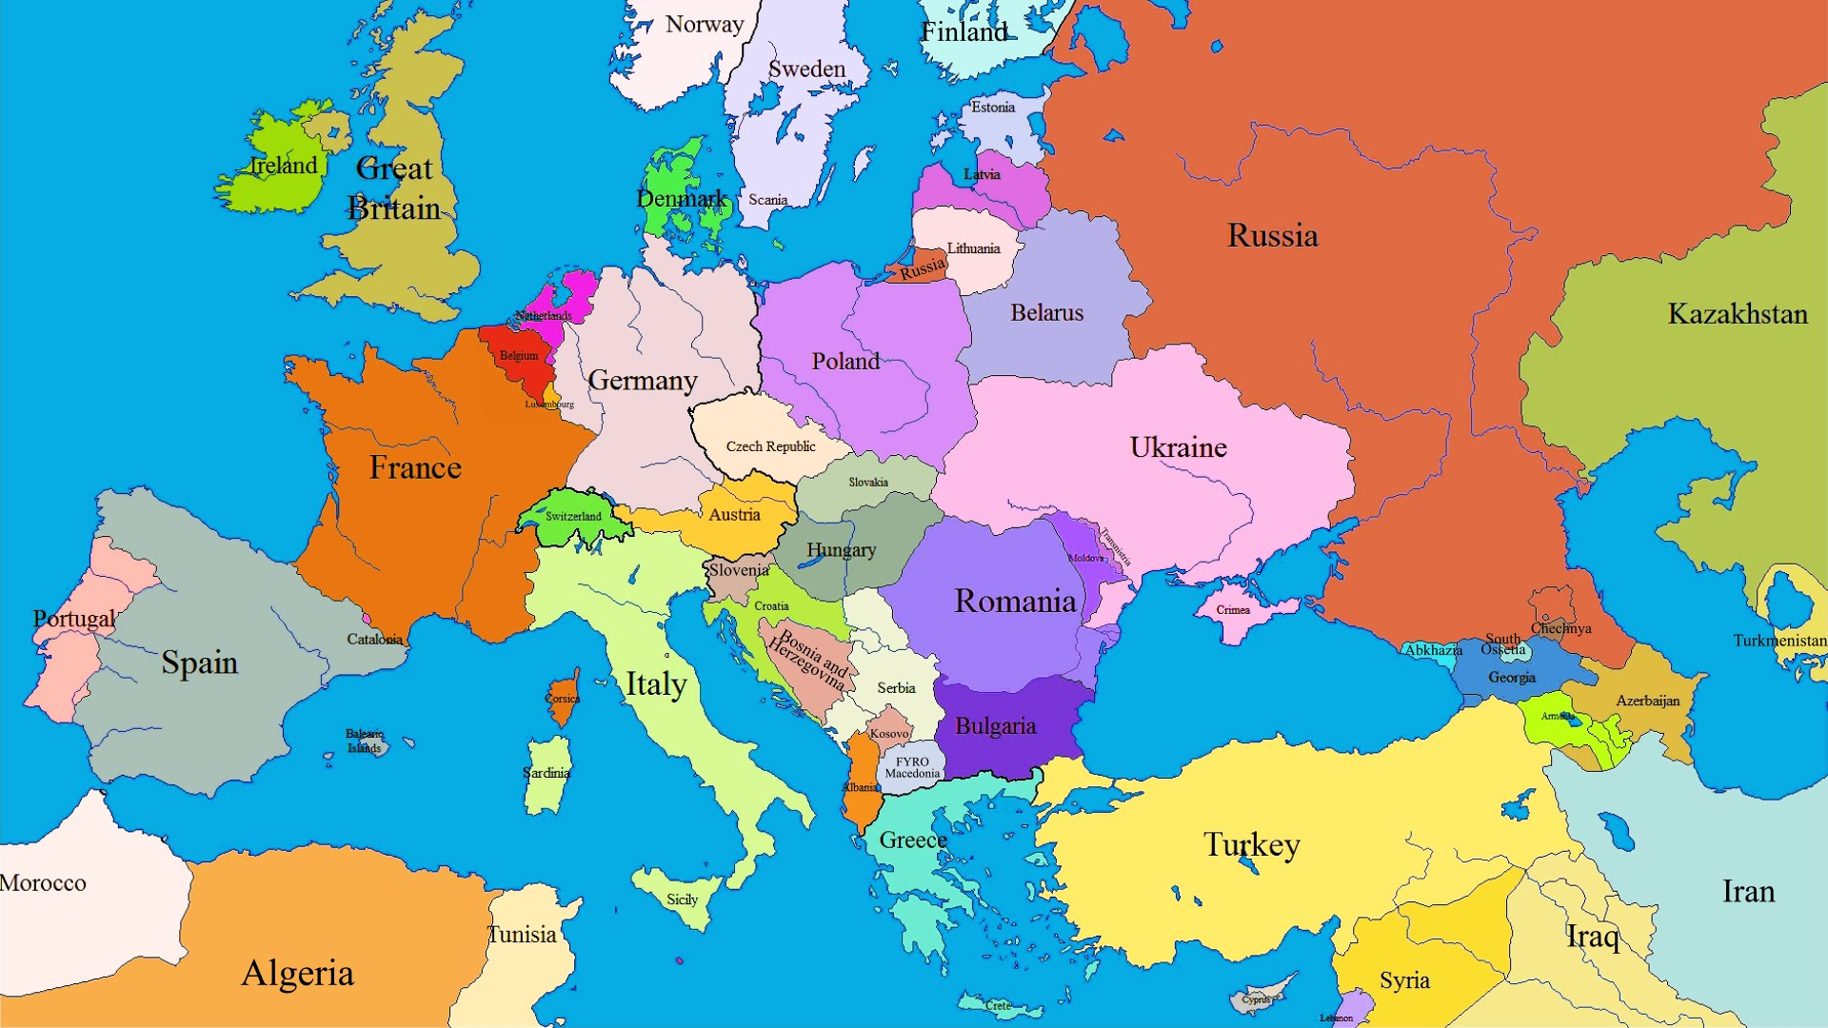
EUROPEAN
9
COUNTRIES
IN THIS PROJECT
1
www.sosgsm.cz

Slide 3
WHERE
WERE WE?
LATVIA
FRANCE
PORTUGAL
GERMANY
TURKEY
BULGARIA
SPAIN
2
www.sosgsm.cz

Slide 4
CZECH STUDENTS
34
AND TEACHERS
ON THE ROAD
3
www.sosgsm.cz

Slide 5
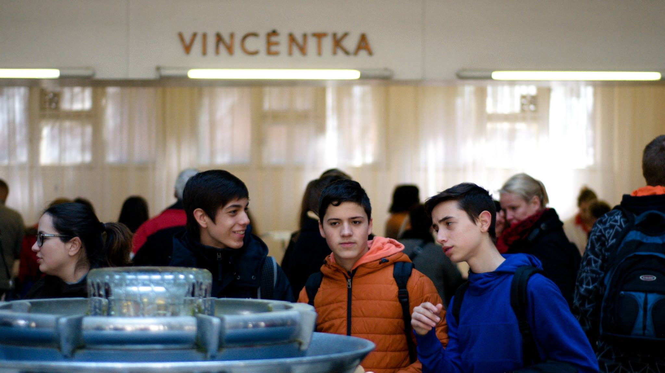
MEETING IN THE
1
CZECH REPUBLIC
4
www.sosgsm.cz

Slide 6
TEACHERS AND
33
STUDENTS
5
www.sosgsm.cz

Slide 7
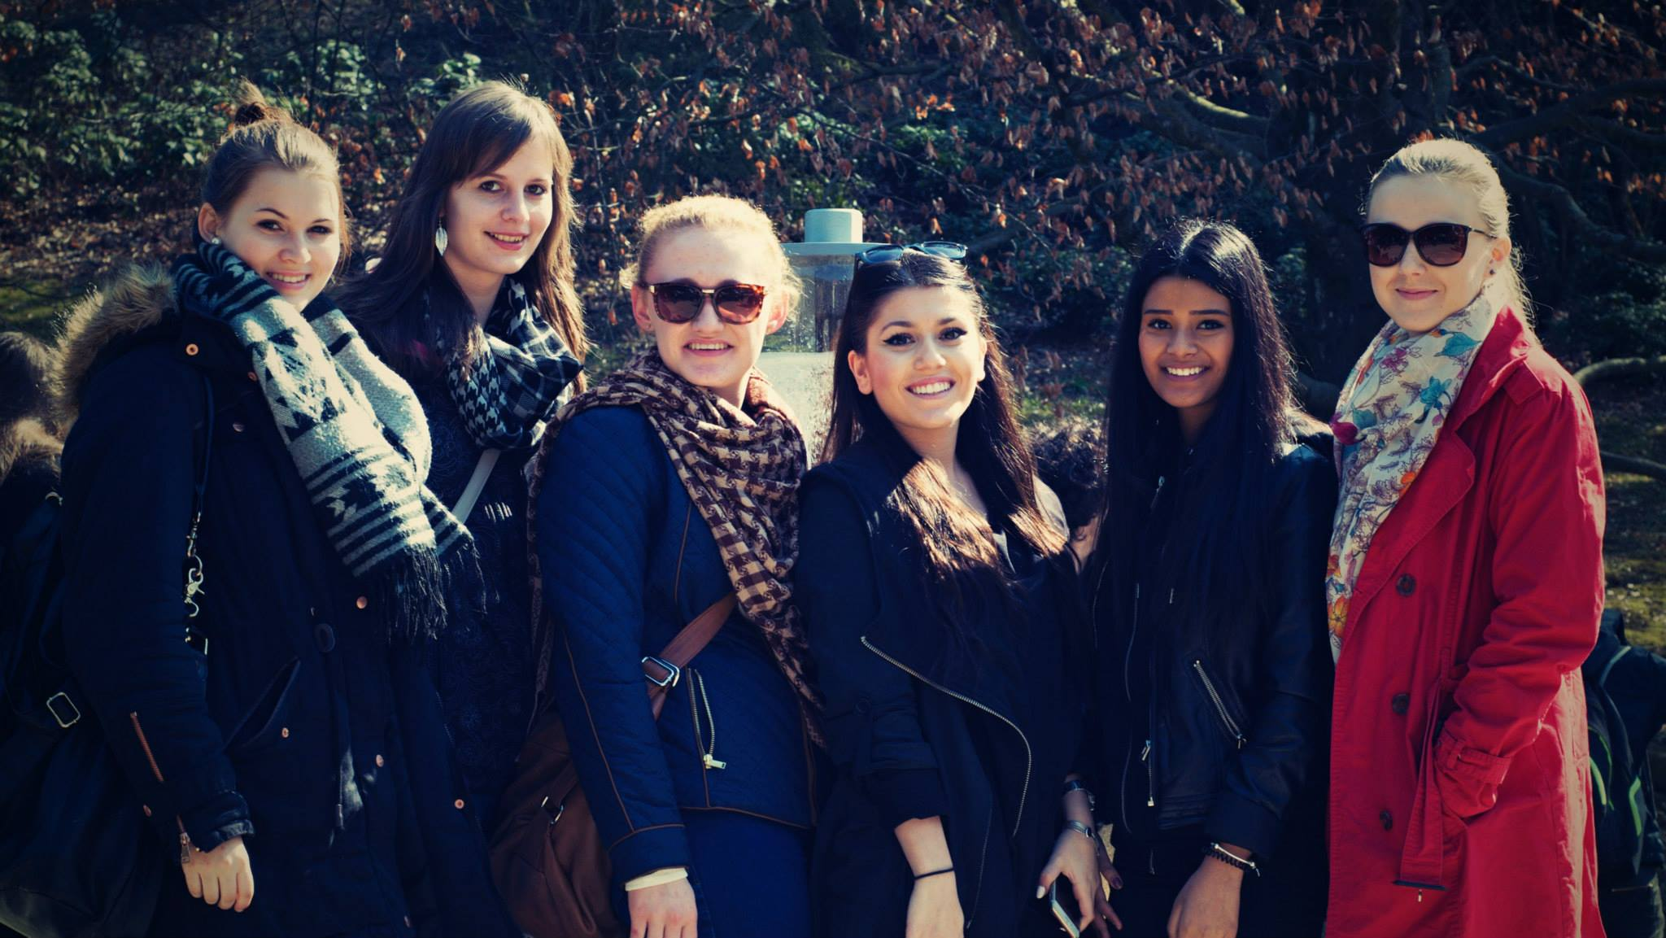

Slide 8
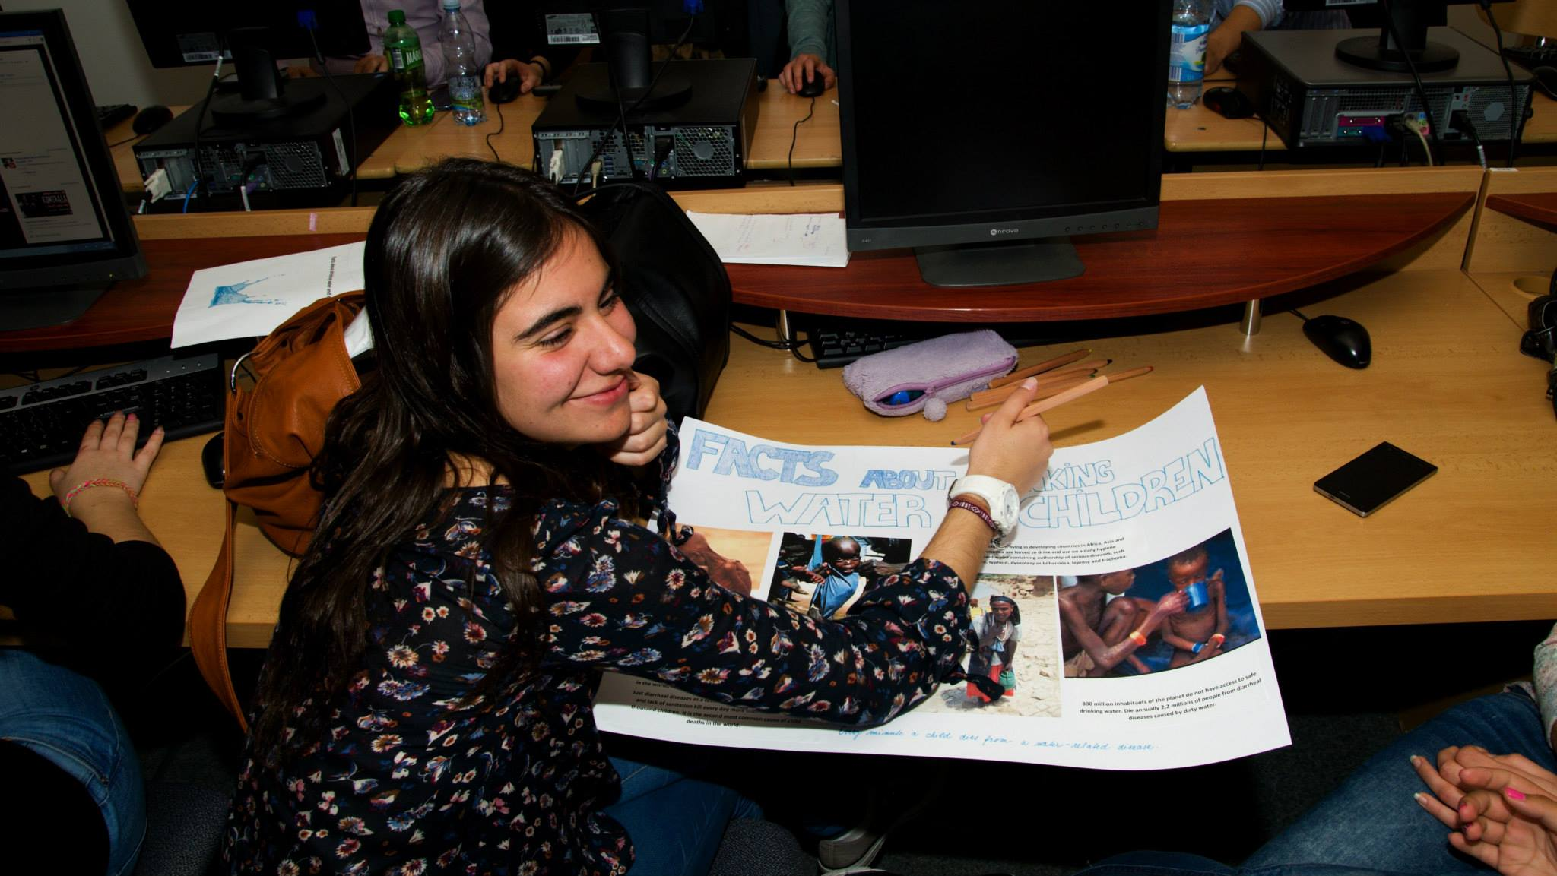

Slide 9
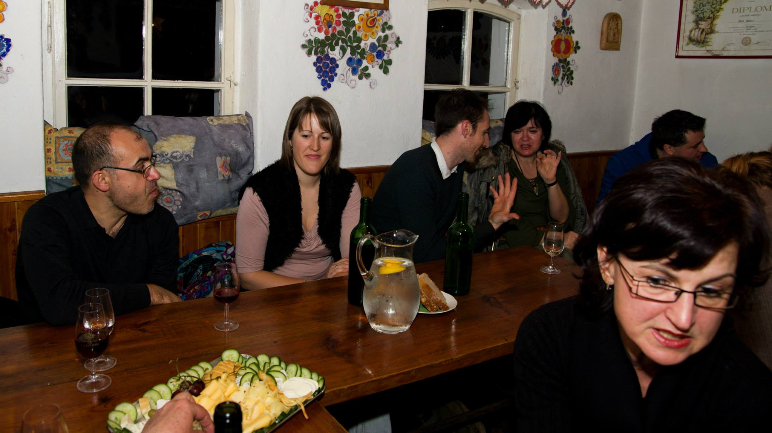

Slide 10
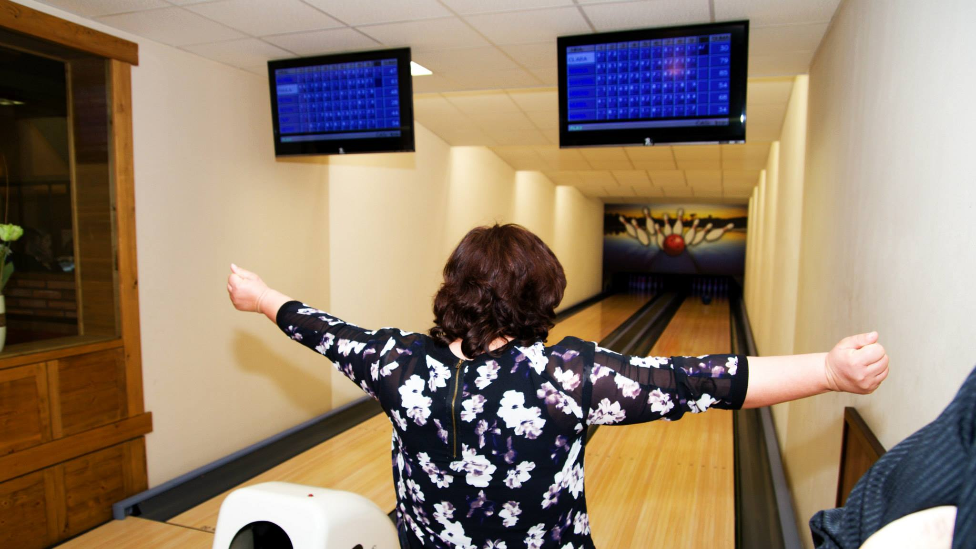

Slide 11
OUR WORK
PRESENTATIONS
POSTERS
FILMS
GAMES
SCHOOL BEER
4
12
3
2
1
10
www.sosgsm.cz

Slide 12
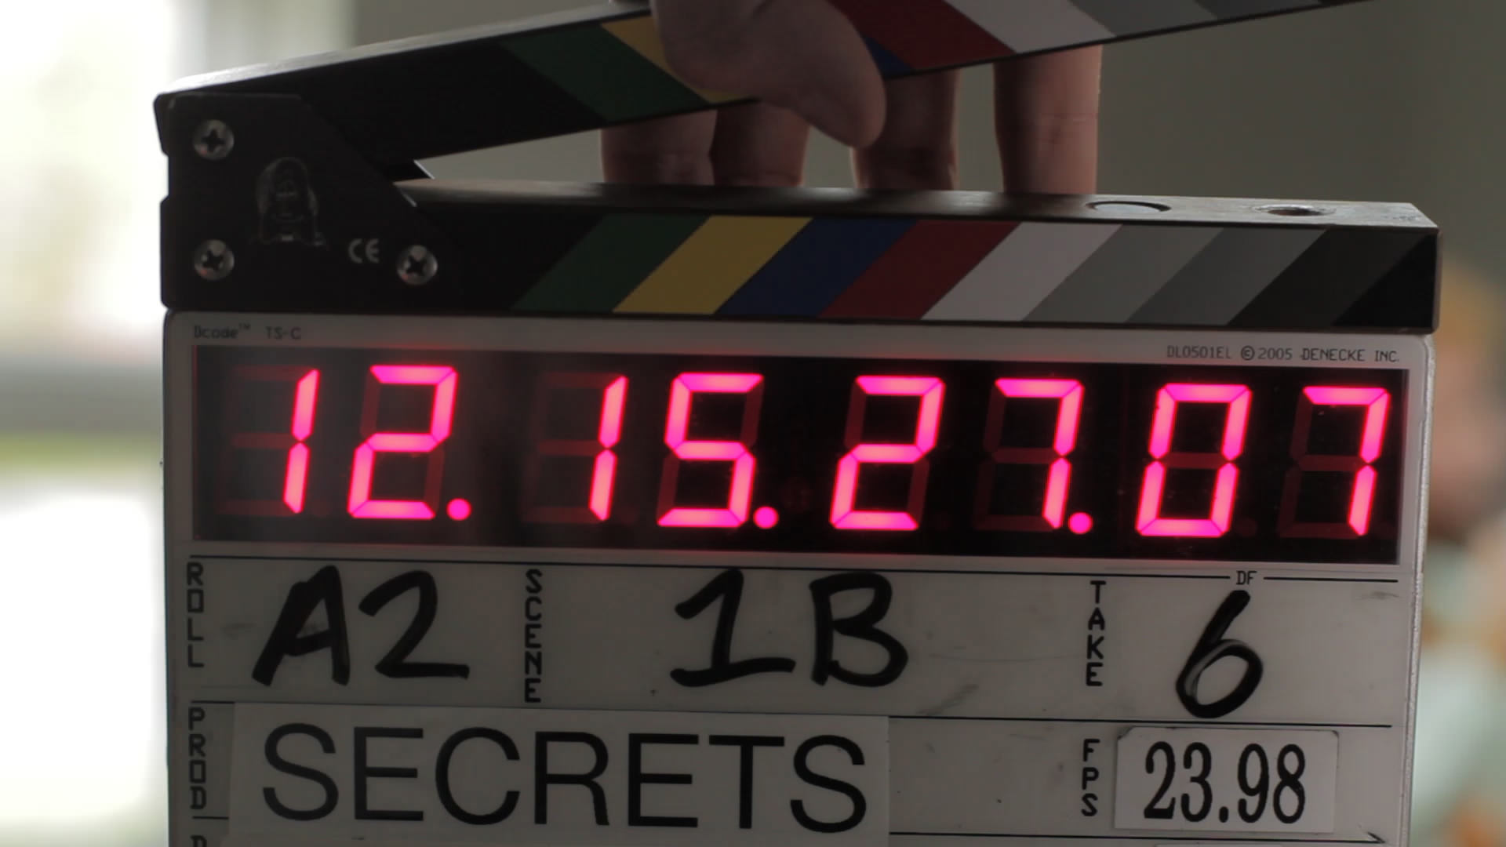
FILMS ABOUT
3
WATER
11
www.sosgsm.cz

Slide 13
CZECH SCHOOL BEER
1
ST
10
12
www.sosgsm.cz

Slide 14
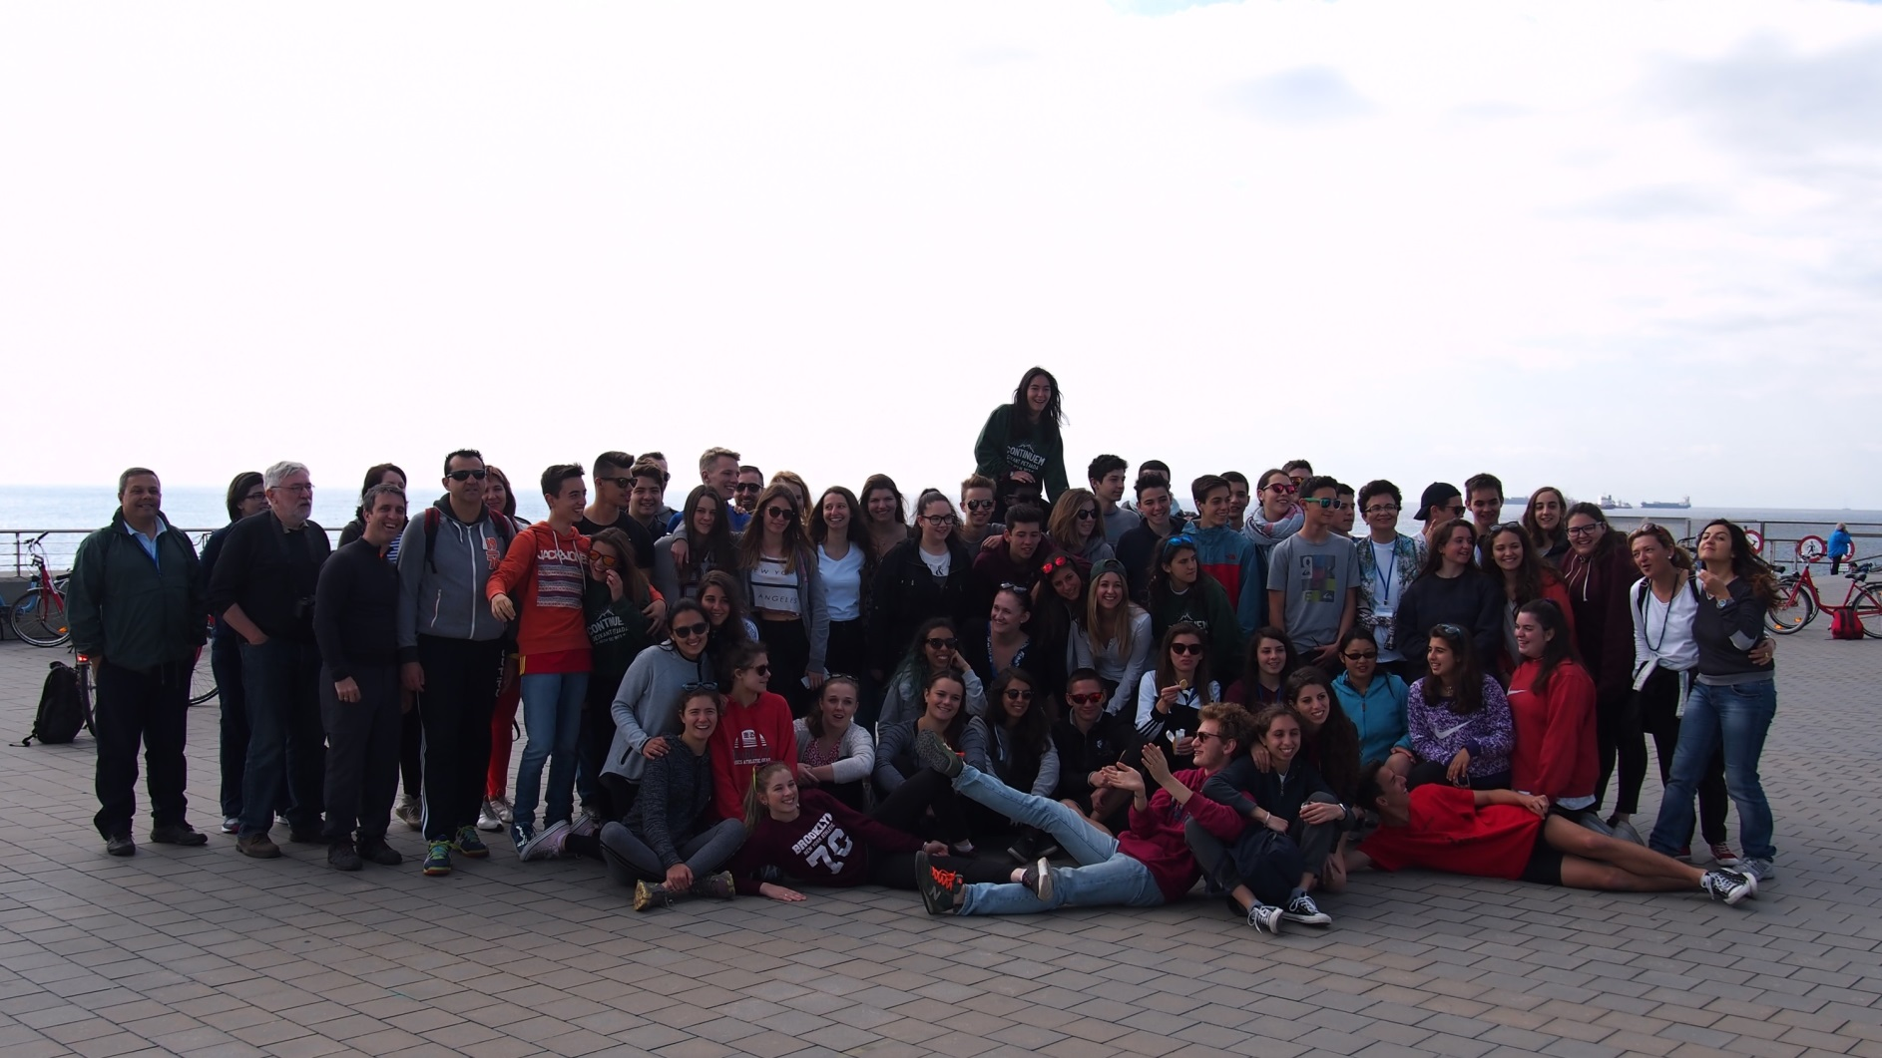
WHAT DID THE PROJECT BRING TO US?
01
03
NEW EXPERIENCE
BETTER ENGLISH
02
AWARENESS OF EUROPEAN CULTURES
13
www.sosgsm.cz

Slide 15
?
AND WHAT ELSE
DID THE
PROJECT BRING
TO US?
14
www.sosgsm.cz

Slide 16
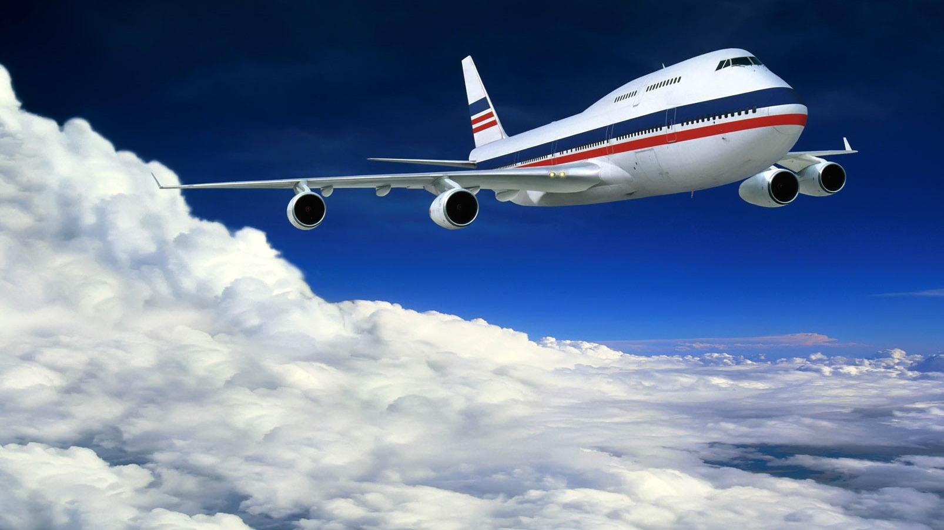
17
606
KM BY
PLANE
15
www.sosgsm.cz

Slide 17
50
DAYS ON
THE ROAD
16
www.sosgsm.cz

Slide 18
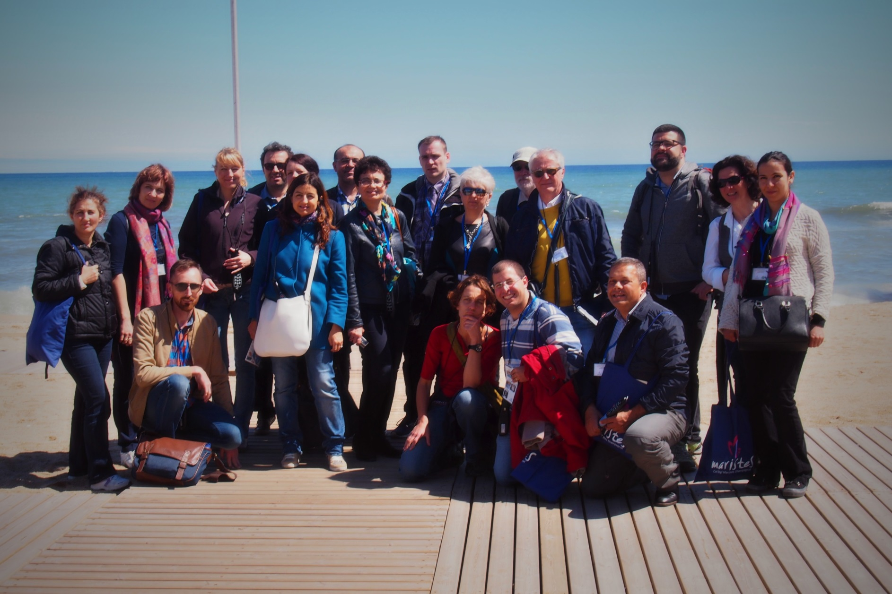
UN
COU
TED
ENJOYMENTS
17
www.sosgsm.cz

Slide 19
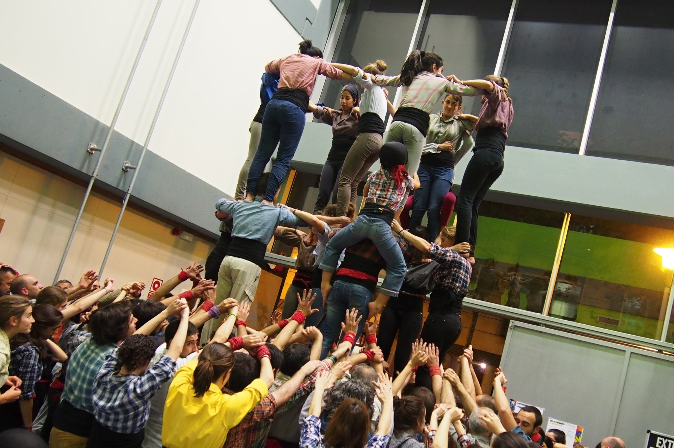
BIG THANKS
10
000
TO LATVIAN
TEAM FOR WRITING
THIS PROJECT
18
www.sosgsm.cz

Slide 20
TED
19
www.sosgsm.cz

