Slide 1
Weather lores

Slide 2
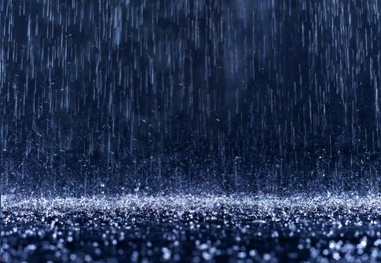
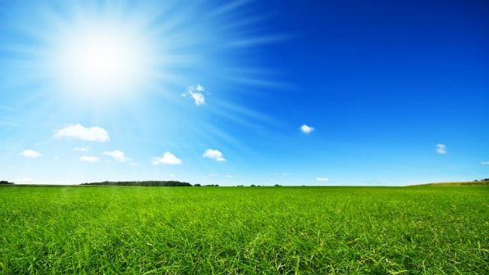
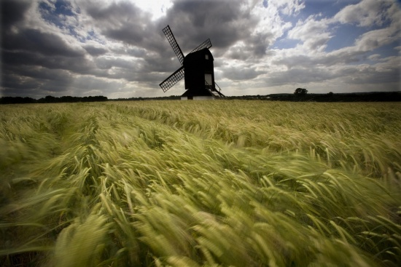
a) it´ll rain.
b) it´ll be sunnny.
c) it´ll be windy.
If the flowers smell more than usual…

Slide 3
a) it´ll rain.
If the flowers smell more than usual…

Slide 4
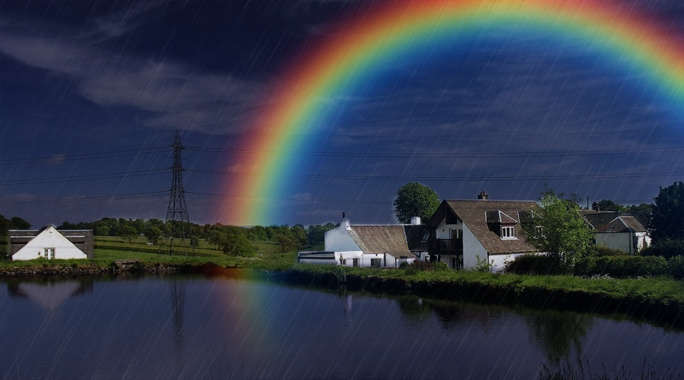
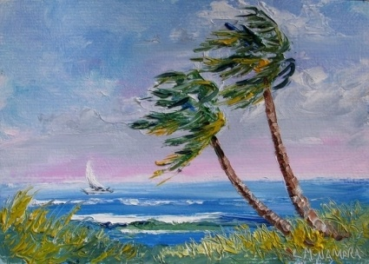
If it‘s raining and violets bloom…
a) it´ll be rainbow.
b) it´ll be windy.
c) it´ll be sunny.

Slide 5
If it‘s raining and violets bloom…
c) it´ll be sunny.

Slide 6
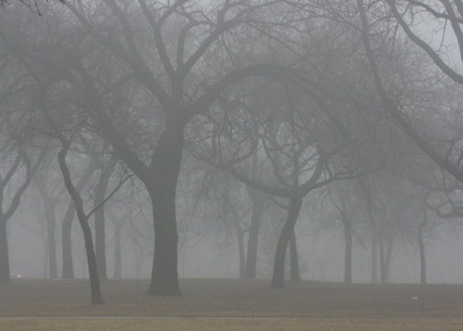
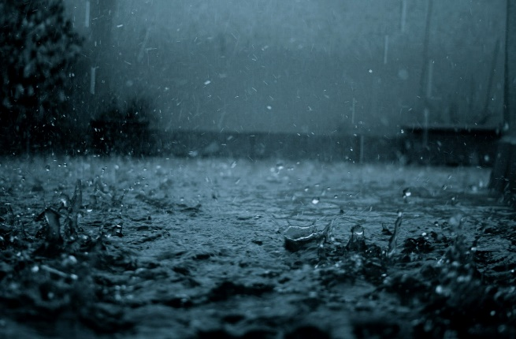
If a spider tears his web in two pieces in July…
a) it´ll be sunnny.
b) it´be foggy.
c) it´ll rain.

Slide 7
If a spider tears his web in two pieces in July…
c) it´ll rain.

Slide 8
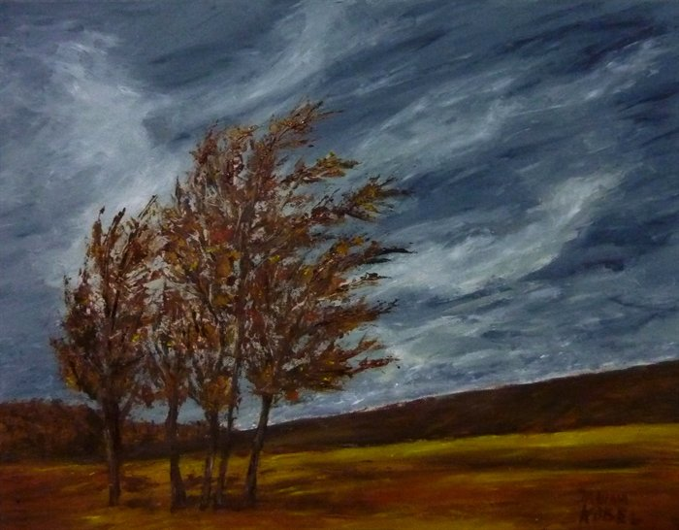
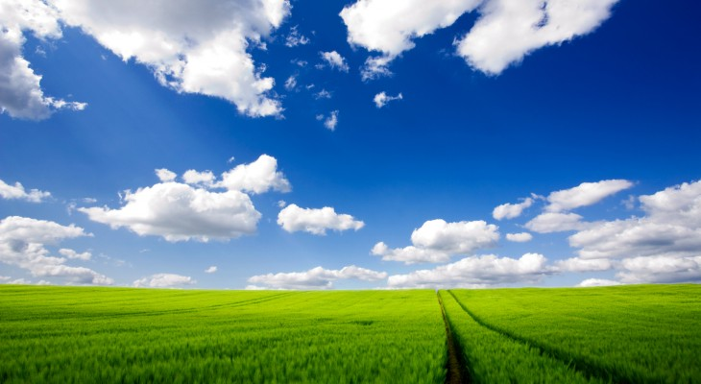
If fish jump very high above the water level…
a) it´ll be windy.
b) it won´t rain.
c) it´ll rain.

Slide 9
If fish jump very high above the water level…
c) it´ll rain.

Slide 10
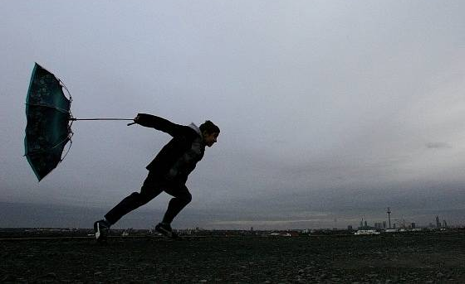
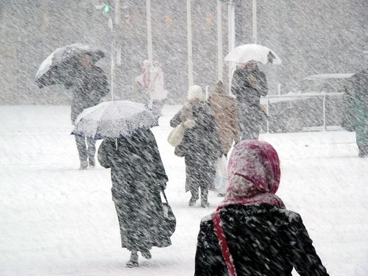
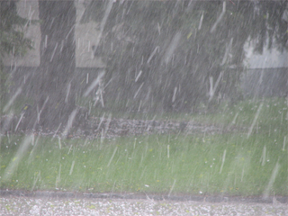
A lot of mushrooms – a lot of…
a) gales.
b) snowstorms.
c) hail.

Slide 11
A lot of mushrooms – a lot of…
b) snowstorms.

Slide 12
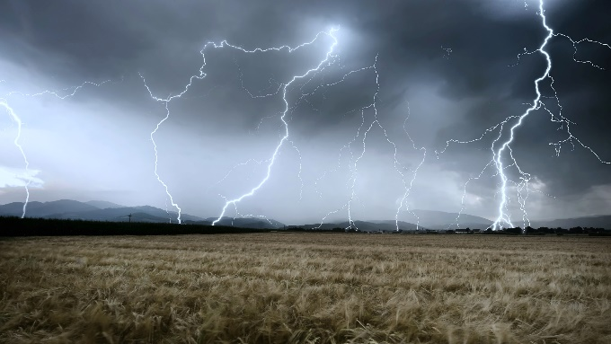
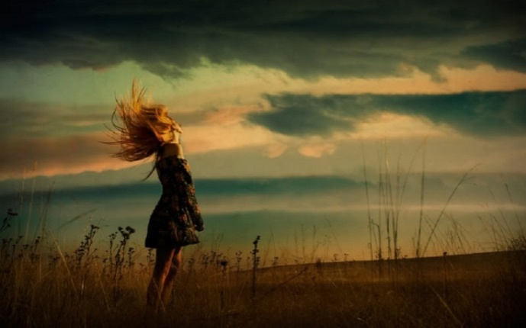
a) it won´t rain.
b) it´ll be storm.
c) it´ll be windy.
As long as frogs stay in the water – even if the weather is cloudy…

Slide 13
a) it won´t rain.
As long as frogs stay in the water – even if the weather is cloudy…

Slide 14
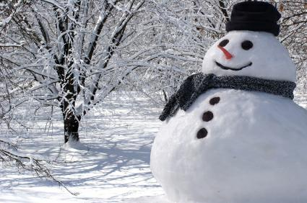
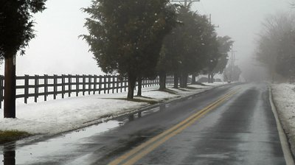
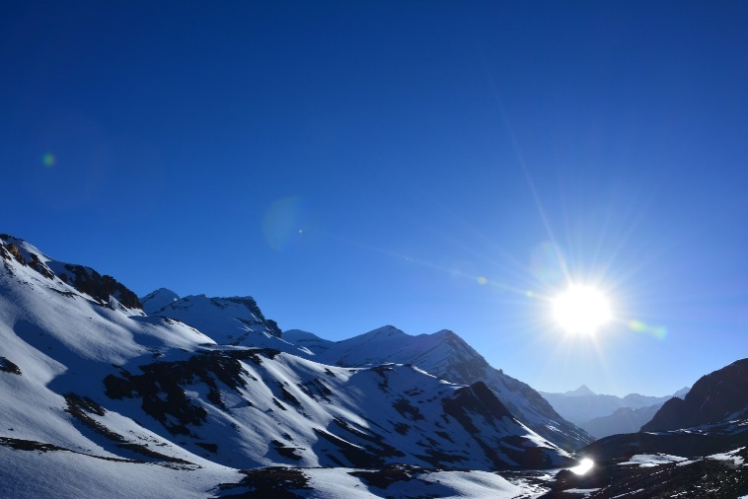
a) snowy.
b) rainy.
c) sunny.
If the leaves fall down from
trees in October – the winter will be…

Slide 15
b) rainy.
If the leaves fall down from
trees in October – the winter will be…

Slide 16
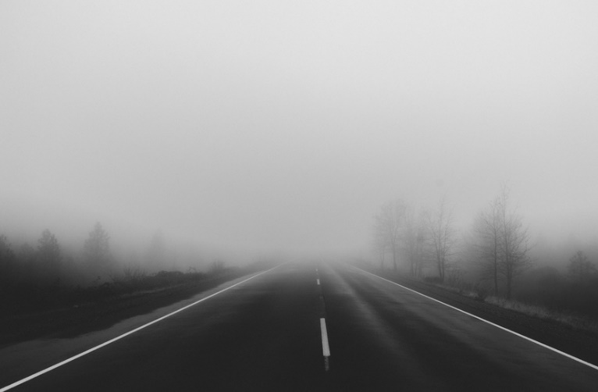
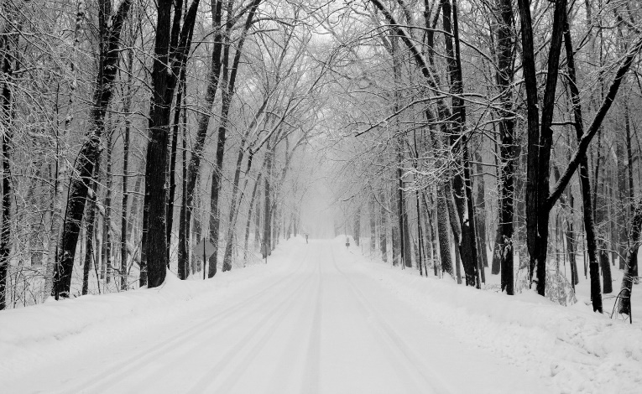
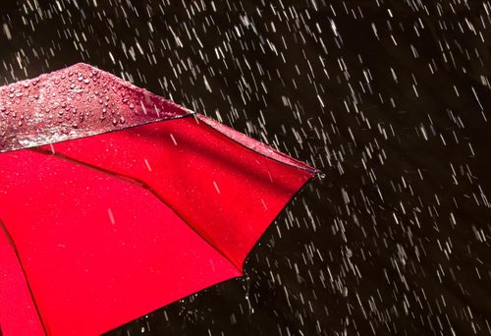
If cat is scratching a broom…
a) it ´ll be foggy.
b) it´ll snow.
c) it´ll be rainy.

Slide 17
If cat is scratching a broom…
c) it´ll be rainy.

